Slide 1
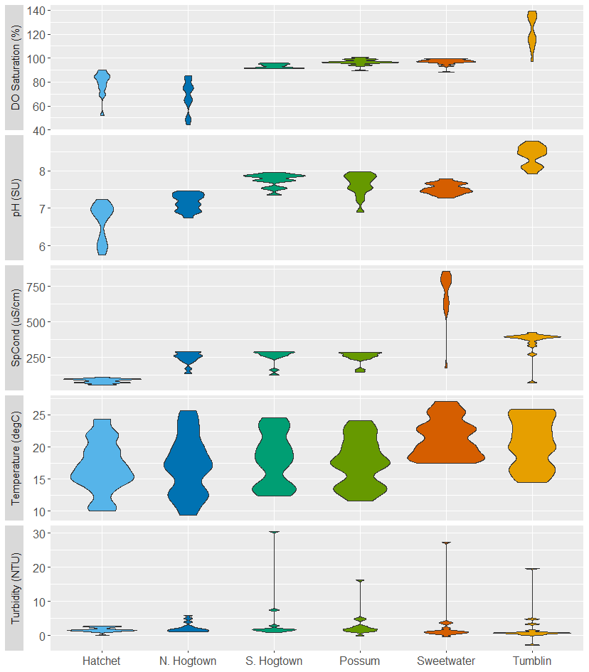
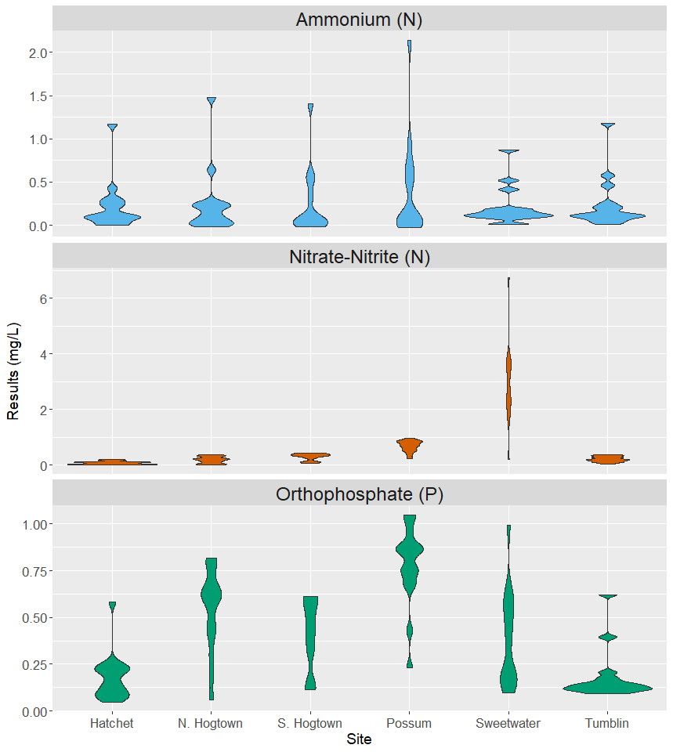
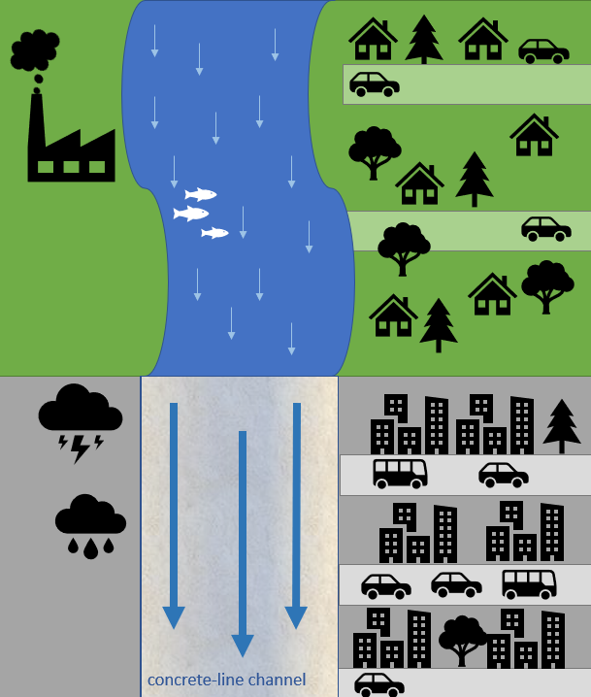
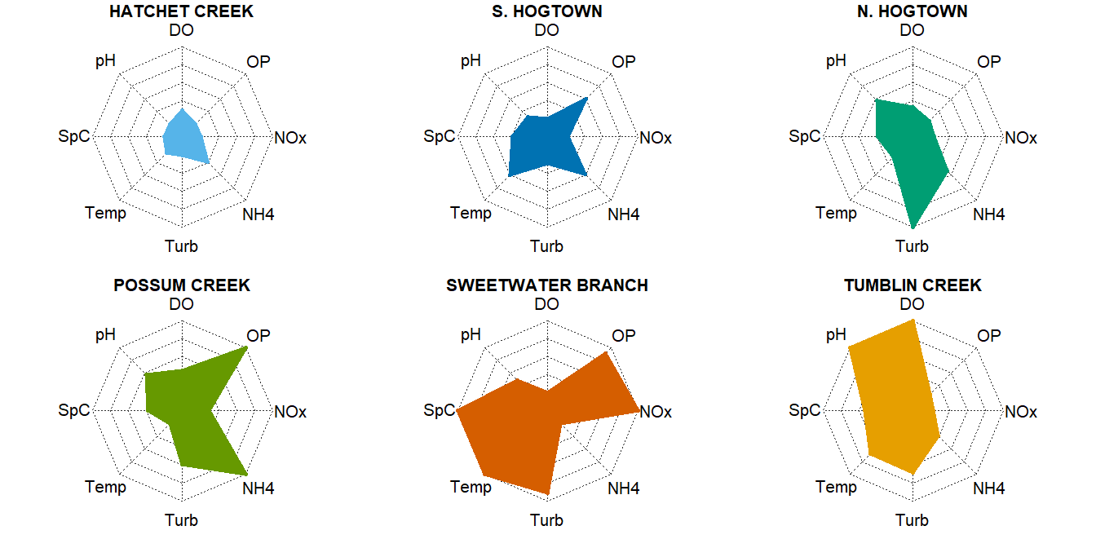
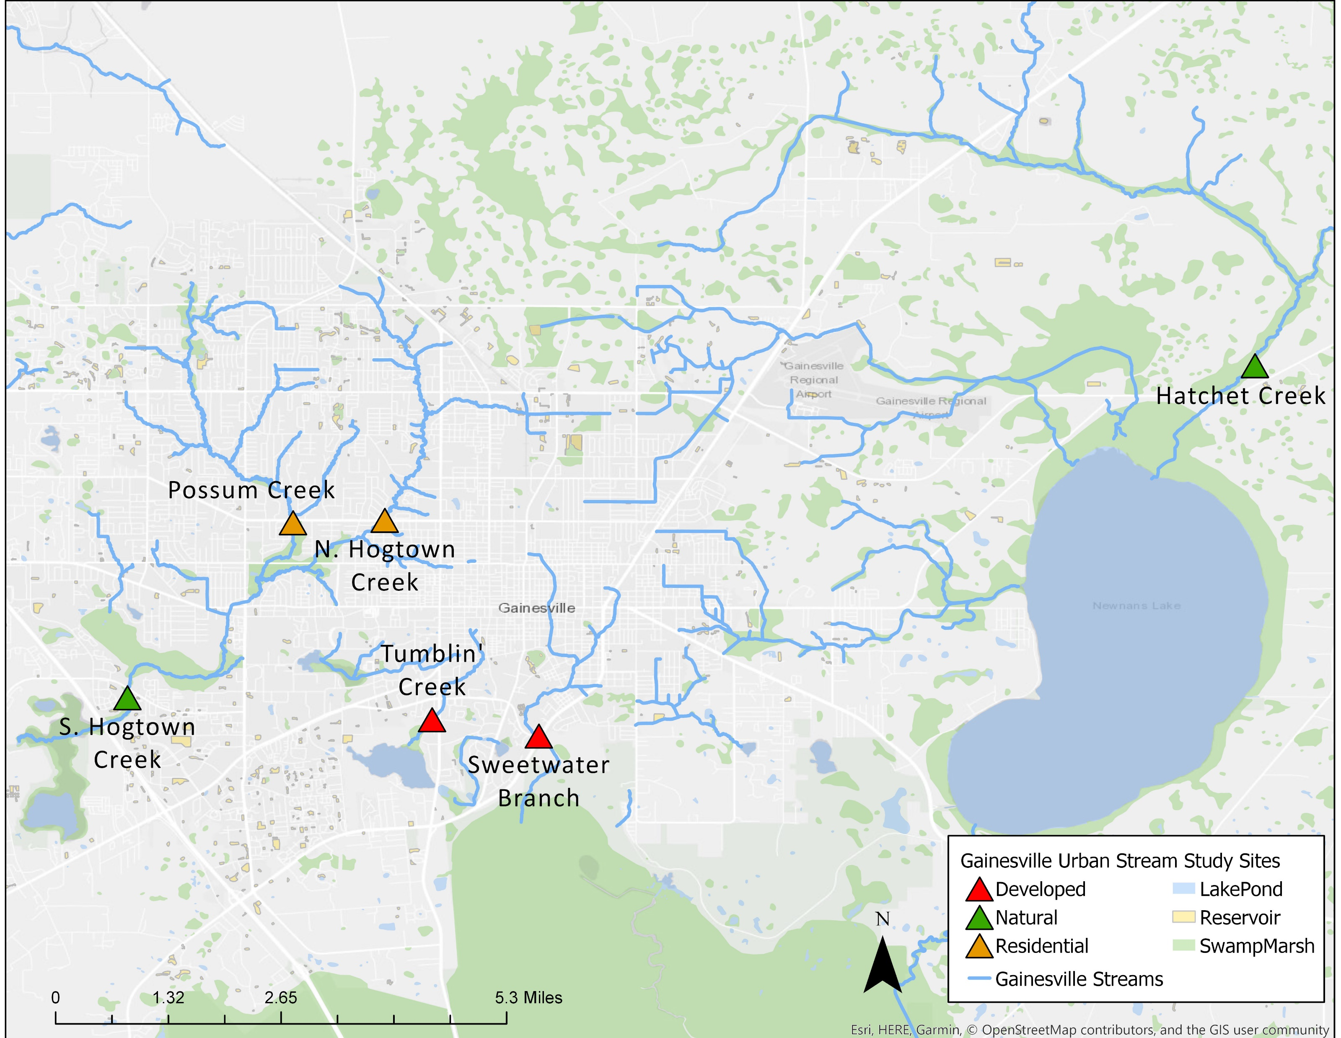
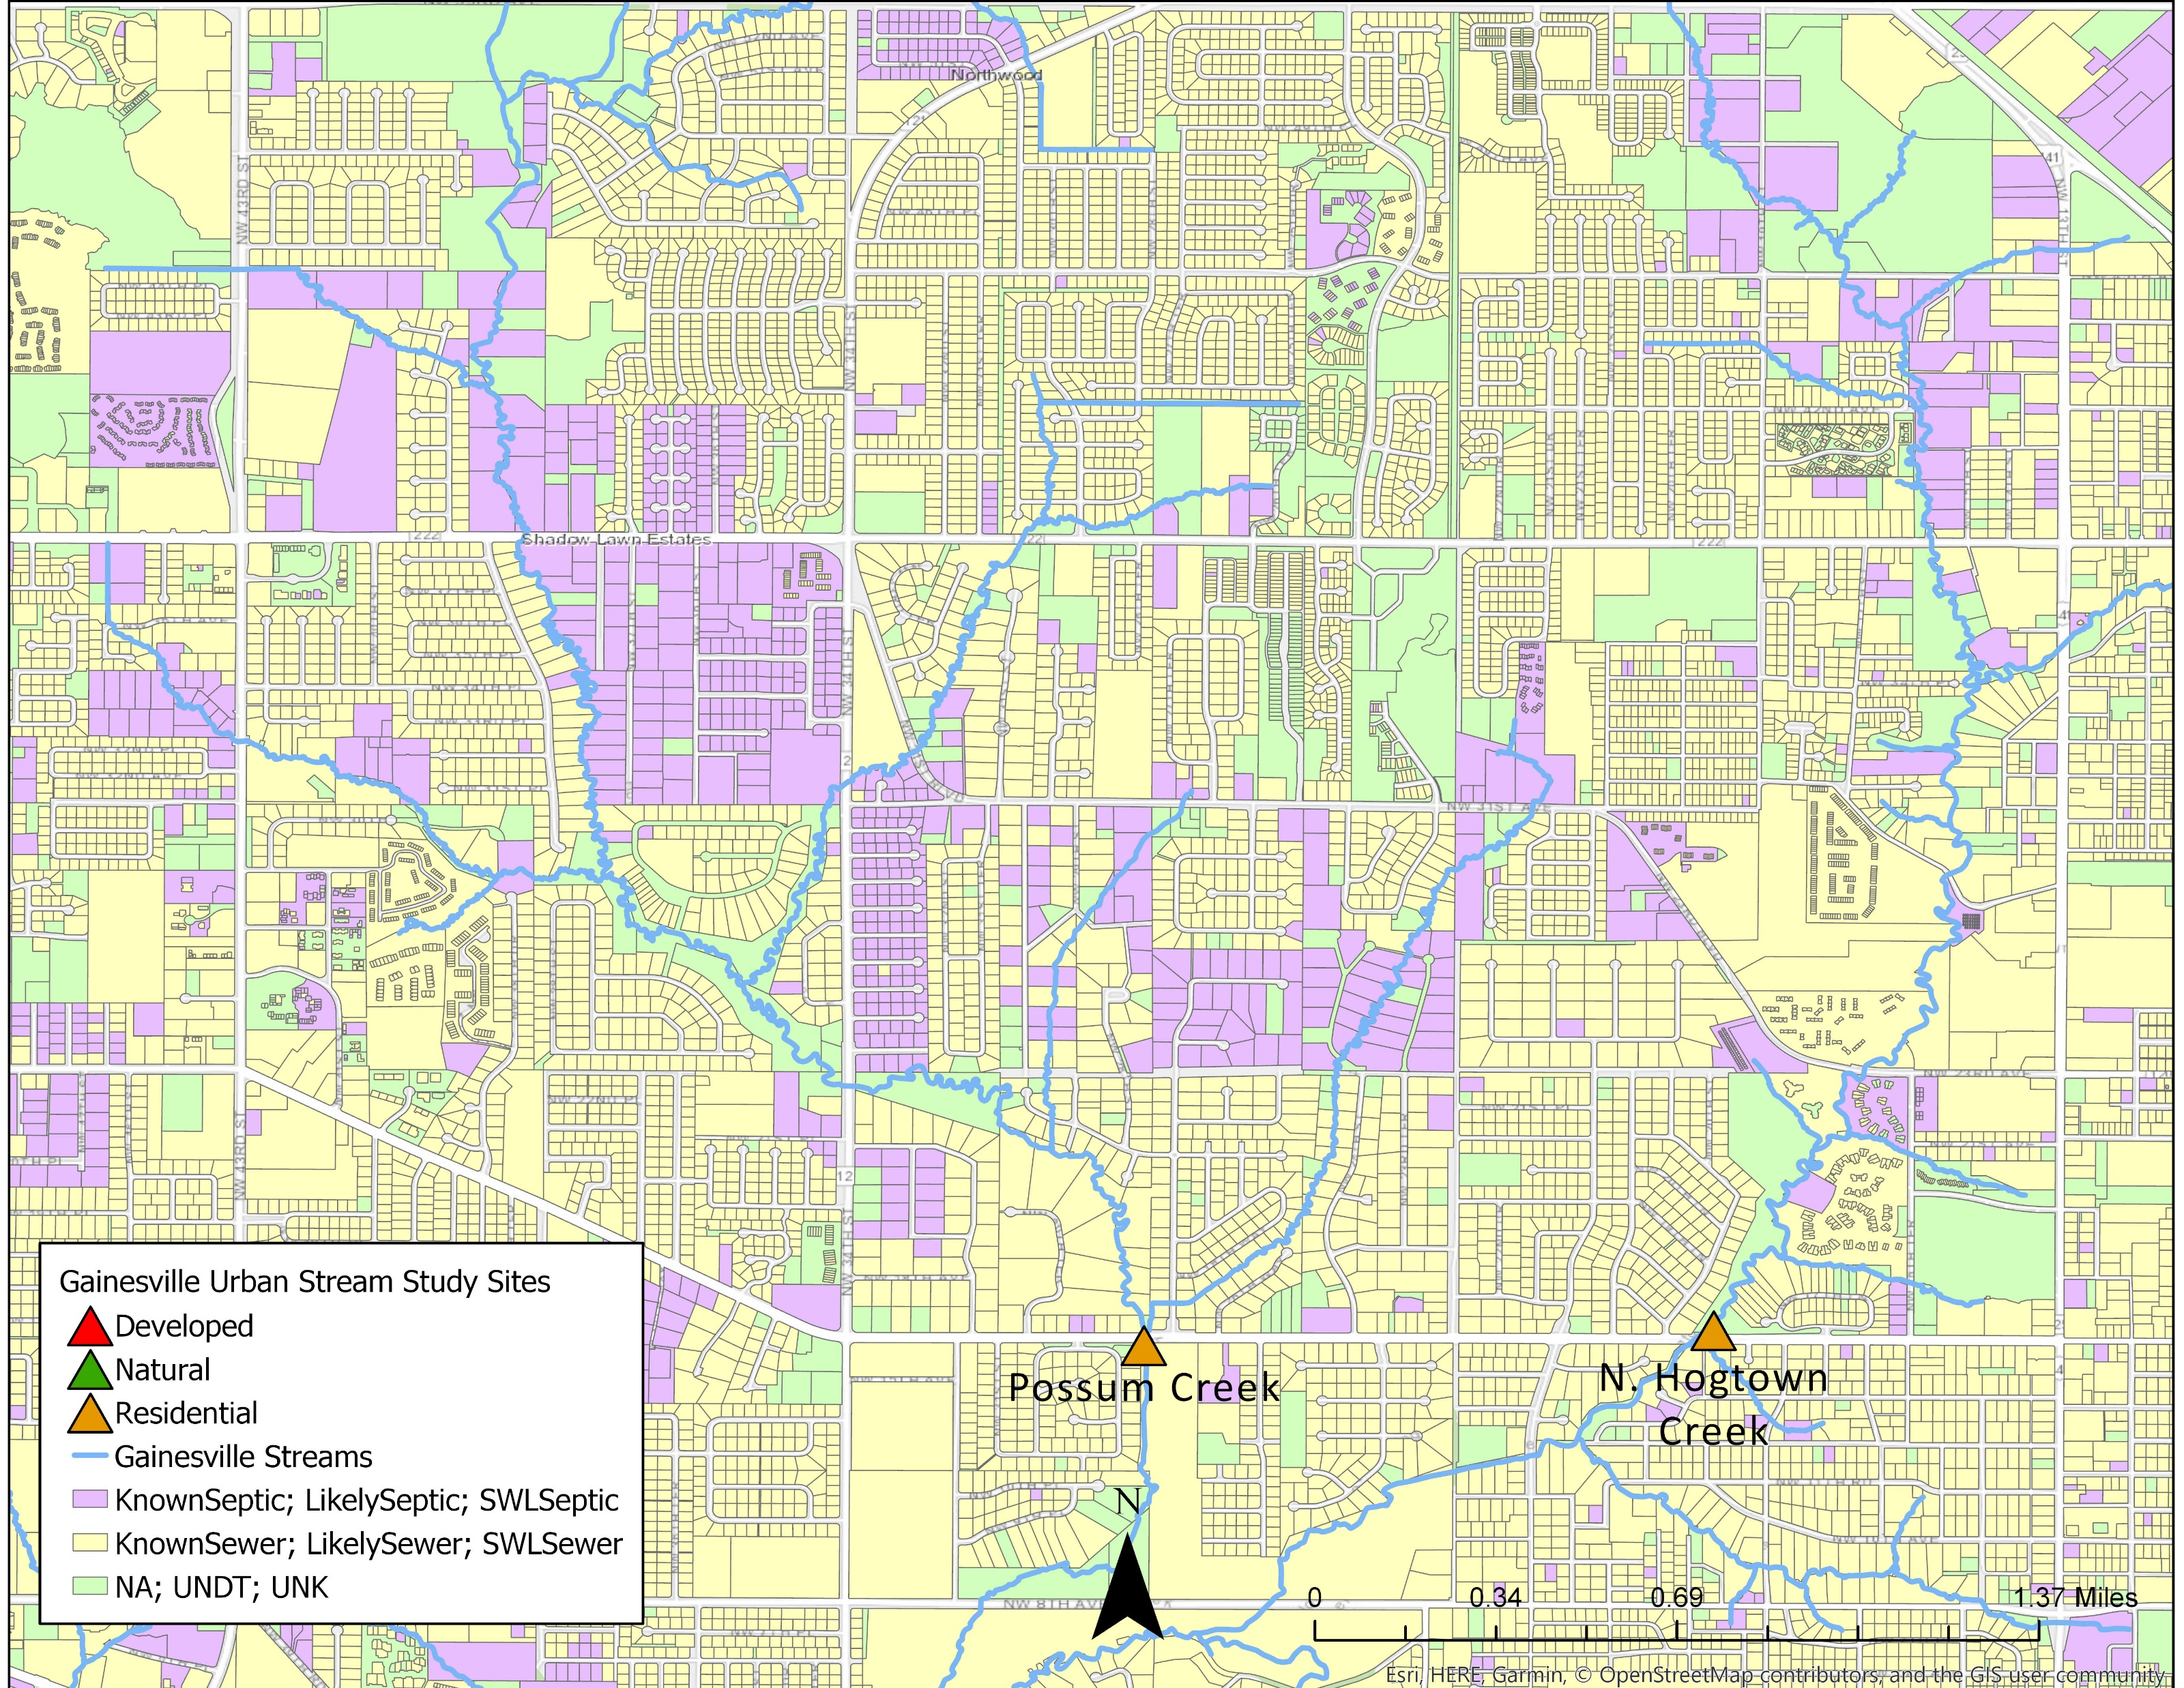
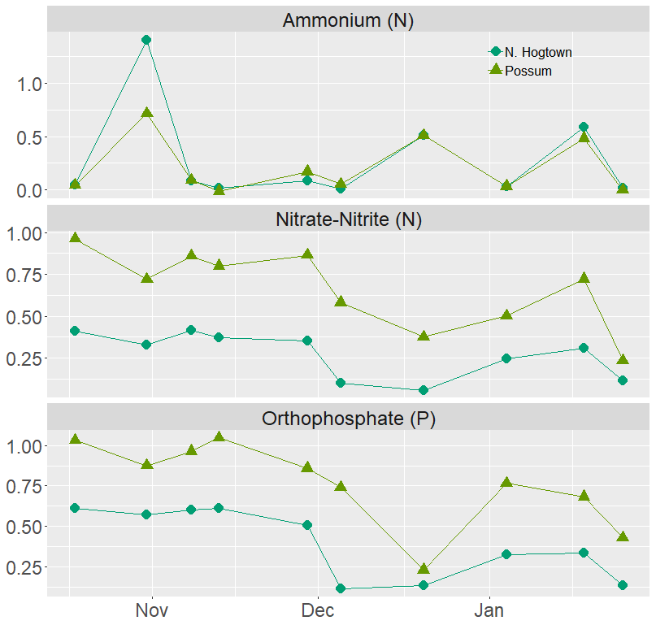
BACKGROUND
RESULTS AND DISCUSSION
Urban development is altering the hydrology and water chemistry of streams through changes in watershed land cover, chemical inputs, biological responses.
Wastewater management practices
Residential housing densities and land management practices
Changes or loss in biodiversity
Dramatic responses to storm events
NATURAL
RESIDENTIAL
DEVELOPED
Changes in streambed composition

